Slide 1
IDOL Update CCS Safety Director’s Forum August 25, 2021
Michelle Ellison, Deputy Commissioner
Jeremy Galloway, Director of Construction Safety

Slide 2
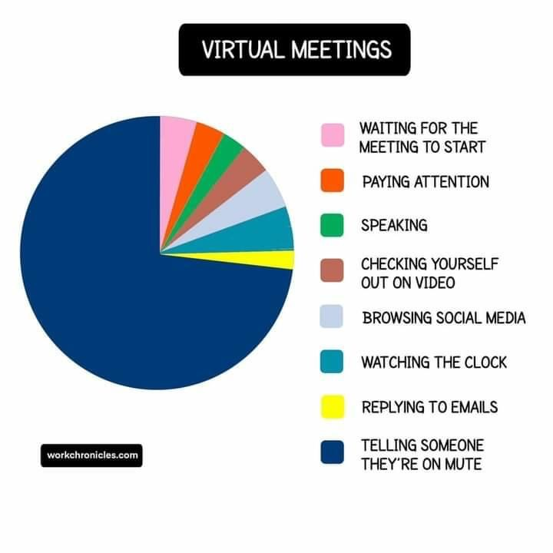
An Early Morning Funny…

Slide 3
IDOL Leadership
Joe Hoage
Commissioner of Labor
Kenneth R. Boucher II
Deputy Commissioner
Michelle Ellison
Deputy Commissioner
Jameson Berry
Director of General Industry
Jeremy Galloway
Director of Construction Safety

Slide 4
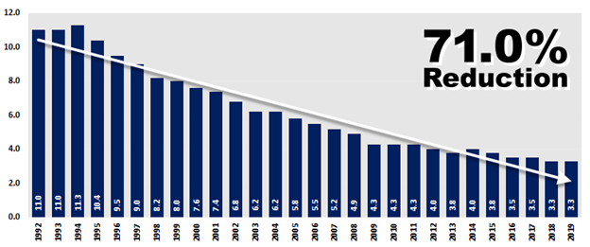
Nonfatal Workplace Injury and Illness Rate
Source: Federal Bureau of Labor Statistics’ Survey of Occupational Injuries and Illnesses for 2019
Notes:
2019 SOII released on November 4, 2020.

Slide 5
2019 SOII Highlights
The 2019 overall state rate is tied with the 2018 for a historic low of 3.3 per 100 full-time workers
Nine Hoosier industries experienced decreases in the nonfatal workplace injury and illness rate
Educational services sector experienced highest decrease (42.86%)
The Hoosier manufacturing industry experienced nearly a 10% decrease from 4.1 in 2018 to 3.7 per 100 full-time workers
The 2019 Hoosier construction industry rate was 2.7 which represents a slight increase from 2.6 in 2018
Source: Federal Bureau of Labor Statistics’ Survey of Occupational Injuries and Illnesses for 2019

Slide 6
2019 Highest Major Hoosier Industries
Local Government: 5.3 (4.6 in 2018)
Agriculture, forestry, fishing, and hunting: 4.7 (3.6 in 2018)
Transportation and Warehousing: 4.7 (4.4 in 2018)
Source: Federal Bureau of Labor Statistics’ Survey of Occupational Injuries and Illnesses for 2019

Slide 7
2019 Hoosier Construction Industry Worker Injuries and Illnesses
Approximately 1,200 worker injuries/illnesses resulted in 1 or more days away from work
2019 median number of days away from work = 6
2018 median number of days away from work = 3
800 cases with days away from work occurred in the specialty trade sub-industries
Contact with objects, equipment: 35%
Falls, slips, trips: 32%
Overexertion and bodily reaction: 22%
Source: Federal Bureau of Labor Statistics’ Survey of Occupational Injuries and Illnesses for 2019

Slide 8
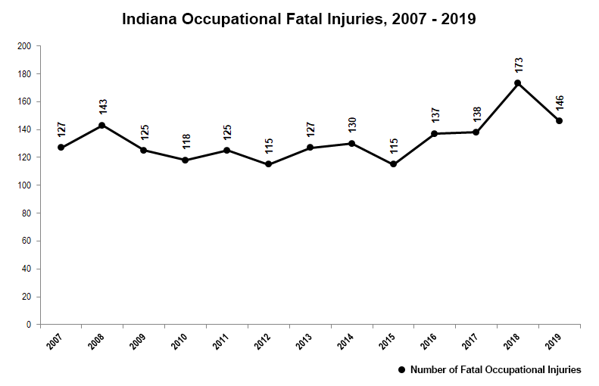
2019 Fatal Workplace Injuries
Source: Federal Bureau of Labor Statistics’ Census of Fatal Occupational Injuries for 2019

Slide 9
2019 Fatal Workplace Injury Demographics
146 Workplace fatalities
135 men
11 women
42 self-employed individuals
104 wage and salary earners
Source: Federal Bureau of Labor Statistics’ Census of Fatal Occupational Injuries for 2019

Slide 10
2019 Hoosier Worker Fatalities by Industry
Highest Industries
Construction: 20, a decrease of 11 from 2018
11 falls, slips, or trips
4 transportation-related incidents
Agriculture, forestry, fishing and hunting: 18, a decrease of 12 from 2018
10 transportation-related incidents
Retail Trade: 14
Source: Federal Bureau of Labor Statistics’ Census of Fatal Occupational Injuries for 2019

Slide 11
2019 Fatal Workplace Injuries in Indiana by Event
Highest Fatal Events
Transportation incidents: 55, a decrease of 23 from 2018
Contact with objects and equipment: 24, a decrease of 8 from 2018
Falls, slips, or trips: 24, of which 11 (46%) occurred in the construction industry
Violence and other injuries by persons or animals: 19, decrease from 22 from 2018
Source: Federal Bureau of Labor Statistics’ Census of Fatal Occupational Injuries for 2019

Slide 12
Local Emphasis Programs
LEPs promote awareness of and address hazards or industries that pose a workplace safety or health risk to workers
IOSHA does not need to see a hazard to stop
New LEPs:
December 4, 2020: Falls (e.g., fall-related hazards) in General Industry and Construction
December 4, 2020: Renovation, Rehabilitation, and Demolition
May 3, 2021: Residential Construction Projects
LEP/NEP webpage: www.in.gov/dol/3147.htm
Notes:
General LEP Information:
There were 56 fatal falls to a lower level in Indiana in 2014-2018. 25 in construction and 31 in general industry.
There were 11 fatalities in the NAICS code 23891 in 2014-2018. This NAICS is associated with Site Preparation Contractors.
2018 Nonfatal construction industry injury and illness rate – 2.6
Non-residential construction – 2.7
Residential construction – 5.8
Between 2014-2018, there were 92 construction fatalities in Indiana, over 20% occurred on residential construction sites

Slide 13
LEP – Falls
Covers both Construction and General Industry worksites
From 2014 to 2018 in Indiana, there were 56 fatal falls to a lower level in Construction (25) and General Industry (31).
There were 22 fatal falls to a lower level in the Construction industry in 2018 (11) and 2019 (11).
In Indiana in 2018 and 2019, there were 8,570 nonfatal fall-related injuries.

Slide 14
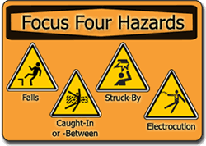
LEP – RenoDemo Hazards
Electrical
Ungrounded electrical installations
Improperly labeled or unlabeled electrical installations
Fall
Unguarded floor openings
Airborne Contaminants
Asbestos
Silica
Lead
Struck-by and Caught-in-between
Removal of existing building materials
Heavy equipment
Buildings that are structurally weak
www.osha.gov/training/outreach/construction/focus-four

Slide 15
LEP – RESCON Hazards
Trusses, including the loading of trusses before they are secured and braced and erection without proper equipment
Floor Openings, including stairways; balconies; fireplaces; etc.
Power Tools, including defective or inadequate guards; frayed or damaged power cords; electrical shocks; and failure to provide GFCI
Pneumatic Tools with inadequate or missing guards or lack of proper training

Slide 16
LEP – RESCON Hazards (cont.)
Amputations: saws whose guards have been altered, damaged, or removed, training
Scaffolds: training, fall protection, safe access, as well as proper erection and dismantling.
Electrical hazards: overhead power lines, unprotected or incomplete interior electrical work, and improper temporary electrical supply
Struck-by and Caught-in-between hazards: moving equipment and machinery, improper lifting of large building materials
Ladders: damaged equipment, improper use, and lack of training

Slide 17
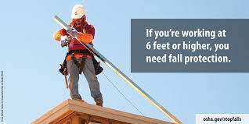
LEP Enforcement Summary (Preliminary)
Falls
112 inspections (88 Construction-related)
Unprogrammed - 91
Complaint – 53
Referral – 28
Unprogrammed Related – 10
Fatality – 1
Programmed
20
286 citations issued
256 classified as Serious
21 classified as Other
9 classified as Repeat
Source: Preliminary enforcement data, subject to change as data is updated (12/4/2020 – 8/15/2021)

Slide 18
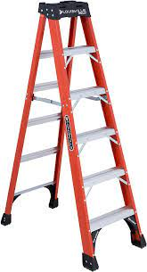
LEP Enforcement Summary (Preliminary)
DemoReno
10 inspections
Unprogrammed – 9
Complaint – 7
Unprogrammed Related - 2
Programmed
1
17 citations issued
13 classified as Serious
4 classified as Other
Source: Preliminary enforcement data, subject to change as data is updated (12/4/2020 – 8/15/2021)

Slide 19
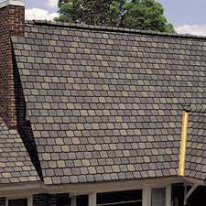
LEP Enforcement Summary (Preliminary)
RESCON
35 inspections
Unprogrammed – 2
Complaint – 2
Programmed
33
57 citations issued
42 classified as Serious
15 classified as Other
Source: Preliminary enforcement data, subject to change as data is updated (5/4/2021 – 8/15/2021)

Slide 20
IOSHA Most Frequently Cited
1926.20(b)(1), Safety and Health Program
1926.95(a), PPE
1926.501(b)(13), Residential Fall Protection
1926.100(a), Head Protection
1926.503(a)(1), Fall Protection Training
1926.20(b)(2), Competent Person
1926.21(b)(2), Hazard Recognition
1926.1053(b)(1), Ladders, 3-foot extension
1926.1060(a), Ladder Training
1926.453(b)(2)(v), Fall Protection in Aerial Lifts
Source: Preliminary enforcement data, subject to change as data is updated (10/1/2020 – 8/15/2021)
Notes:
IOSHA Most Frequently Cited
Top 10 standards cited make up more than half of the IOSHA cited violations.

Slide 21
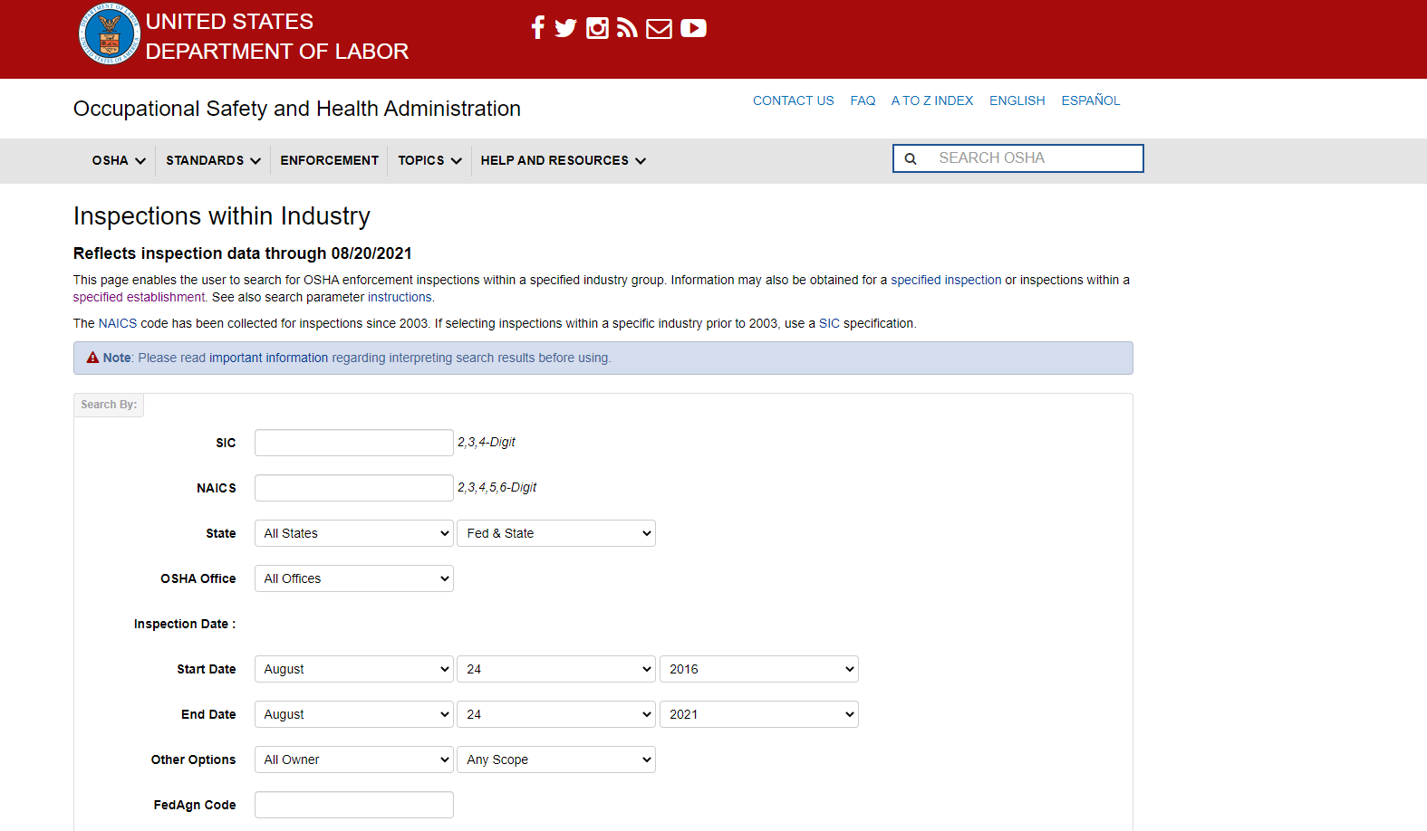
End Notes
Source: Preliminary enforcement data, subject to change as data is updated (10/1/2020 – 8/15/2021)
Notes:
IOSHA Most Frequently Cited
Top 10 standards cited make up more than half of the IOSHA cited violations.

Slide 22
Contact Us
Indiana Department of Labor
(317) 232-2655
www.in.gov/dol
INSafe
www.in.gov/dol/insafe.htm
IOSHA
www.in.gov/dol/iosha.htm
OSHA
www.osha.gov

